Slide 1
Rigorous and family-centered
Safety Planning
Advanced SDM® training for California
child protection

Slide 2
Recognizing traditional stewards of the land
Notes:
Purpose
To open with a land acknowledgement.
Example
Evident Change is committed to promoting racial equity and social justice. We use this slide to pause and acknowledge the original owners of the land we now occupy.
Trainer Note
Evident Change staff can find guidance for this activity here
https://nccd.sharepoint.com/resources/arre/Shared%20Documents/Honoring%20the%20land%20guidance%20document.pdf?CT=1609802898142&OR=OWA-NT&CID=6e0d0912-ae61-f474-7b4e-a2a6276959dd
Other agencies can access https://www.lspirg.org/knowtheland for an introduction to how a land acknowledgement can be written.

Slide 3
Agenda
Assessing child safety
and the SDM safety assessment
In-depth look at steps
of safety planning
Essential elements
of a safety plan
Closing and next steps
Skills lab: Practice adapting plans using CQI tools
Notes:
Purpose
To provide an overview of training content.
Example
This training will focus on creating safety plans that are rigorous, are effective, and are created with the family.
We will begin by anchoring our thinking in the foundational concepts of the Structured Decision Making® (SDM) safety assessment. We will review techniques for using the assessment in alignment with core practice model strategies to support decision making about immediate safety and safety planning.
Next, we will review the steps for safety planning, including creating a shared understanding of safety with families using harm and worry statements. We will go back and forth between content and practice to deepen learning on the essential elements of a safety plan, using a case vignette.
We will finish with an opportunity for you to practice adapting and strengthening safety plans, using your own case or an example case.
A full training on SDM safety assessment fundamentals is included in the training module called “Interviewing for the SDM Safety Assessment” and will not be repeated here.
The training will be three hours long, and we will have at least one 15-minute break about halfway through.
Training Objectives
Review techniques for using the SDM safety assessment, in alignment with core practice model strategies, to support decision making around immediate safety and safety planning.
Build skills for family engagement that creates a shared understanding of identified safety threats and the safety planning process with families.
Learn the essential elements of safety plans for child protection, aligned with state and federal guidance, research, and best practice.
Practice monitoring, adapting, and strengthening safety plans using continuous quality improvement (CQI) review tools such as the safety plan checklist

Slide 4
Why Safety Planning?
Historically, the child protection system conceptualized removal to equal safety.
Research shows that removal is not without harm, and there are many benefits of supporting children’s safety in their homes and communities.
California statewide data indicate a need for enhanced practice in this area, particularly in relation to concerns of neglect, which continue to be the top safety threat leading to removal.
Notes:
Purpose
To provide a reminder that most children do not want to be uprooted from their home if it is avoidable.
Example
We are going to talk about creating safety plans today. This will not eliminate the need for foster care.
But if we think about the history of child protection, we have operated under the assumption that removing children from their families will equal safety and that the state will do an adequate job of being a parent.
Research tells us there are many reasons to support every effort to prevent removal. According to the research, children who are separated from their families not only experience trauma and attachment disruptions that can cause long-term harm, but they also often suffer a lot while in foster care. Youth often experience additional abuse or neglect once in foster care. Removal creates significant and lasting trauma, and at times it can pose increased risk for children and should be used as a last resort only when safety cannot be controlled in the home.
Across California, the top safety threat being selected in households experiencing a removal is safety threat 3 (immediate needs not met (See California Combined Comparison Data 2021.pdf). For us, this raises questions about whether every opportunity to make a plan to keep a child safe with their parents is being explored.
Discussion/In Chat
What does this get you thinking about?

Slide 5

introductions
Notes:
Purpose
To introduce the group.
Example
In chat, share the following.
Introduction (name, role)
One thing you are hoping to learn about safety planning today.
Name one thing that is bringing you joy this week.
Training Note
Trainer may start with an exercise of their choice for trainer and participant introduction.

Slide 6
Race/ethnicity Disparities: entry into foster care
California Child Welfare Indicators Project (CCWIP); 2022 Disparity Indices: Child Maltreatment Allegation Rates. Outcome (entries): Compared to White
Notes:
Purpose
To center the conversation around safety planning and reasonable and active efforts to preserve the family in race equity.
Trainer Note
Update this figure as needed to show the most recent data for the year, using the California Child Welfare Indicators Project Disparity Indices Entry into Care Report: https://ccwip.berkeley.edu/childwelfare/reports/DisparityIndices/STSG/r/rts/l
Example
It is important that we center this safety-planning conversation on racial equity.
Racial disparity is used to describe inequitable outcomes experienced by one racial group when compared to another racial group.* While racial disparities are observed as early as allegation rates in California, the disparities increase the further a family is drawn into the system. They are significantly pronounced in the rate at which Black and American Indian/Alaska Native children are removed from their families in California as compared to their White or Asian/Pacific Islander counterparts.
*Dettlaff, A. J., & Boyd, R. (2020). Racial disproportionality and disparities in the child welfare system: Why do they exist, and what can be done to address them? The ANNALS of the American Academy of Political and Social Science, 692(1), 253–274. https://doi.org/10.1177/0002716220980329

Slide 7

Safety planning as a part of Reasonable and active Efforts
Preserve
Reunify
Prior to the placement
of a child in foster care
to prevent or eliminate
the need for removal
To make it possible
for the child to safely
return home
Notes:
Purpose
To point out that safety planning is one way that workers can meet the federal mandate to make reasonable efforts, in both ER and Ongoing Services.
Example
"Reasonable efforts" refers to the federal requirement that child welfare agencies make reasonable efforts to preserve and reunify families (1) prior to the placement of a child in foster care, to prevent or eliminate the need for removing the child from the child’s home; and (2) to make it possible for a child to safely return to the child's home.
Generally, these efforts consist of accessible, available, and culturally appropriate services that are designed to improve families’ capacity to provide safe and stable homes for their children.
In the case of an American Indian/Alaskan Native child, "active efforts" means affirmative, active, thorough, and timely efforts to maintain or reunite the child with their family. The Indian Child Welfare Act requires the caseworker to identify, notify, and invite representatives of the child’s tribe and extended family to participate in providing support to the child’s family, including during the assessment of safety and safety planning.
Trainer Note
Depending on the role of training participants (emergency response/investigations or family reunification), pose the following questions.
What are some of the ways that you ensure reasonable efforts are made in your program?
In what ways do you see safety planning as a part of reasonable efforts?
It may be helpful to discuss that different safety plans can have different purposes, such as safety plans to support domestic violence survivors, or safety plans to support someone presenting with suicidal ideation. In this training, we will focus on safety plans that allow the child to safely remain in, or return, home.
Resource
https://www.childwelfare.gov/pubpdfs/reunify.pdf

Slide 8
Integrated Core Practice model and Safety-organized practice
ICPM Principles
Safety-Organized Practice
Family voice/choice
Team-based
Natural supports
Community-based
Culturally respectful
Individualized
Strengths-based
Outcomes-based
Development of good working relationships
Use of critical thinking
and decision-support tools
Building collaborative plans to enhance
daily child safety
Source: The California Children, Youth, and Families Integrated Core Practice Model (ICPM) guide, available at www.dhcs.ca.gov
Notes:
Purpose
To highlight the California Integrated Core Practice Model (ICPM) and Safety-Organized Practice.
Example
Safety planning practice is directly linked to ICPM values, as well as the practices and tools of Safety-Organized Practice. Throughout this training, we will discuss how these practice models can support developing rigorous and family-centered safety plans.

Slide 9

Opening reflection
Think about a time when you made a safety plan and thought it worked well, and a time when you made a plan that did not work out as well as you hoped.
What key elements of the plan made a difference?
Notes:
Purpose
To begin participant engagement with the topic.
Trainer Note
Trainer may start with an introductory exercise of their choice or use one of the options below.
Example
Option 1: Engage participants in small breakout groups, asking them to reflect on and discuss the following questions.
Think about the best safety plan you have ever written or seen.
Think about a safety plan that you struggled with or was not effective in controlling danger.
What are some key elements that made a difference?
Bring everyone back into a large group and share the highlights of their discussion.
Option 2: Ask participants to take a few moments in small groups to answer the question “What is the role of a safety plan in child protection?” Then in a large-group discussion format, have participants share their responses. You will be looking for responses such as the following.
An agreement with caregivers and their safety and support network about actions they will take to control the danger to children in the household.
A plan that controls safety threats and lets children stay with their family when they would otherwise be protectively placed.
A short-term, detailed, behavior-based plan that includes actionable steps that the family and network will take in response to specific dangers.
Trainer Note
If delivering this training remotely, you can ask participants to share their reflections through an mentimeter activity (www.menti.com) to allow anonymity. You may also ask participants to share their responses in chat or unmute and share. For in-person delivery, you can ask participants to write down their response or to share with a neighbor.

Slide 10
Assessing child safety
& essentials elements of a Safety Plan

Slide 11
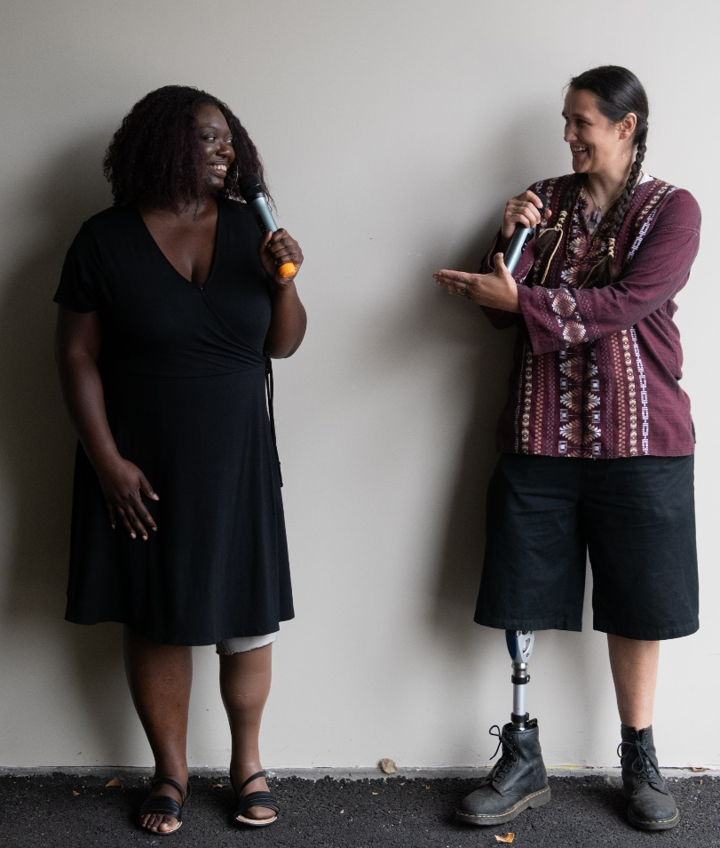
Considering culture in assessment
A family’s cultural traditions are best understood through their own perspective and stories.
An informed assessment requires engaging families in conversations about culture, and paying attention to the way our own bias and norms might impact decision making.
Notes:
Purpose
To learn about cultural considerations as part of basic SDM concepts.
Example
Throughout SDM assessments, caseworkers are asked to assess characteristics of families. The ways in which families and caregivers function are informed by their culture, their values, and community standards. When conducting assessments, caseworkers must ask good questions about the family’s culture and listen to their perspectives about caregiving and household functioning.
When we hold positions of privilege relative to the family we are working with, keys to building trust and understanding caregiver behaviors include using strong engagement and relationship-building skills and listening to the family’s story.
Think about the way that culture and how we each were raised plays a role in how we think about child-rearing and parenting. For example: What do we mean by “inadequate supervision”? How might that differ across cultures?
Trainer Note
Have the group discuss the ways they have seen culture play a role in the assessment of a child’s safety.

Slide 12


SDM guiding Values
Consistency
Accuracy
Equity
Utility
Notes:
Purpose
To discuss the core values of the SDM system and how use of the SDM safety assessment can increase accuracy, consistency, and equity of decision making about removals.
Example
Workers are constantly faced with the task of considering their own implicit bias and how the family culture and parenting norms may be different from their own. The SDM system helps us to maintain a focus on how the behavior impacts the child and whether that impact reaches a specified threshold. In the case of the safety assessment, we are considering whether the concern reaches the threshold of imminent danger of serious harm.
The SDM system is a research-based decision-support system that aims to increase the consistency, accuracy, and equity of decisions made at specific points in child protection.
Consistency: SDM tools seek to increase consistency in decision making, making sure that given the same information, workers come to the same conclusion.
Accuracy: The SDM tools help us to determine which information is most critical to making an accurate decision at that point in the case. It is great to make sure people are coming to the same conclusion, but it is also important to ensure that we are coming to the correct conclusion.
Equity: SDM tools aim to increase equity by making sure that all clients are held to a consistent threshold for intervention.
Utility: Utility is about making sure that the tools are useful—that they work in everyday practice. SDM tools should be useful to the workers in the field, meaning they help in your practice and in making decisions.

Slide 13

SDM Safety Assessment
Imminent danger
of serious harm?
No
Safe
Safe With Plan
Yes
Yes
Could a safety plan be used to respond to the concerns and allow the child to stay at home and in the community?
Unsafe
No
Notes:
Purpose
To provide a visual of how the safety assessment guides the safety decision.
Example
Here is a visual look at the decisions for the safety assessment. You can see that the tool has two questions related to a child’s immediate safety.
If there is imminent danger of serious harm (meaning that one or more safety threats have been selected), we must do something about it. We cannot leave the child in the home without a safety plan in place to mitigate the danger in the short term. It is important to know that answering the second question is a process—we want to make a good faith effort at safety planning before we decide the answer to this question is “no.”
If caregivers are able to take protective actions and necessary intervention actions, the safety decision is “safe with plan.” If caregivers are unable to take protective actions, the safety is “unsafe,” and placement must be considered.
We will talk more about safety planning, and we will conduct some safety planning exercises a bit later. While an initial safety assessment is vital and necessary, the continual assessment of safety throughout the life of a case or a referral is important as well. Safety should continually be on the minds of workers as the case or referral progresses.
Trainer Note
Remind workers that SDM assessments describe an established threshold of a concern. Careful review of the definition of any safety threats selected is recommended, in partnership with a supervisor, to ensure the current concern meets the appropriate threshold of serious and imminent danger.

Slide 14
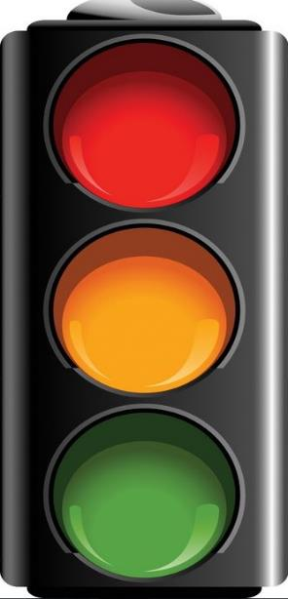
Needs, Risk, and Safety Threats
Safety Threat
Imminent danger of serious harm
Safety Threat
Risk
Likelihood of future child protection system involvement
Risk
Needs
May be related to safety threats or risk
May be addressed on case plan or through other services
Needs
Notes:
Purpose
To distinguish between needs, risk, and safety threats in the SDM system.
Example
Remember that while the terms needs, risk, and safety threat are often used interchangeably in child protection, each one has an important and distinct meaning in the SDM system.
When we talk about safety planning, we often see plans that try to address family risk, complicating factors, or needs instead of focusing on the circumstances causing imminent threat of serious harm. For this training, we will use the following shared definitions.
A safety threat is about the short term. When we talk about danger in the context of the SDM system, we are looking for serious and imminent threats to a child. Serious means the harm would require medical or mental health attention or emergency services. Imminent means the social worker reasonably expects that harm will occur in the next week or month. This is not about “someday.”
Risk is about the long term. Instead of focusing on serious and imminent harm, risk factors are correlated with the likelihood that a family will return to the attention of child protection in the future for alleged maltreatment.
Needs are about underlying conditions in the home; in other words, the root causes that may contribute to the child protection concern. Needs may have contributed to the safety threats or the risk factors—or they may be utterly irrelevant.
Throughout today’s training, we will focus on safety plans that are put in place to respond to an identified safety threat—an imminent threat of serious harm that, if not managed, may lead to protective placement.

Slide 15

State and local policy requirements
All County Letter 17-107
Manual of Policies and Procedures, Division
31-127
Local agency policy
Notes:
Purpose
To highlight that state and local policy provide further guiderails for required elements.
Example
State policy provides the foundations of what essential elements must be included in a safety plan. Social workers should be familiar with where to find county policy related to safety planning to guide local practice.
Trainer Note
Participants can be pointed where they can find local and state policy to follow along with essential elements.
Resources
ACL 17-107: https://www.cdss.ca.gov/Portals/9/ACL/2017/17-107.pdf?ver=2019-06-26-152901-400
ACL 22-02: https://www.cdss.ca.gov/Portals/9/Additional-Resources/Letters-and-Notices/ACLs/2022/22-02.pdf?ver=2022-01-11-144436-347
https://www.cdss.ca.gov/Portals/9/Additional-Resources/Letters-and-Notices/ACLs/2022/22-02.pdf?ver=2022-01-11-144436-347
NOTE: See page 9 for details on safety planning reporting in CWS/CMS.

Slide 16

Safety plan: What does it change?
It changes the direct care environment around the child
until the caregiver
can change long-term behavior.
Notes:
Purpose
To conceptualize a safety plan as temporary changes to the care environment for the child.
Example
A safety plan does not focus on long-term behavior change. Instead, it focuses on changing the care environment around the child so that they are protected from the unresolved danger. Think of it as an umbrella, protecting the child from the immediate impact of the surrounding environment.
Trainer Note
Alternative Example
What is a safety plan? Think about a sprained ankle: We want the ankle to heal, but that will take weeks or months. In the meantime, we want to change the environment around the ankle to protect it from further harm and give it a chance to heal.
When a danger is present, there are usually underlying issues that need time to heal. A safety plan is not about that; it creates temporary safety by changing the environment around the child to provide protection in order to give time for the underlying issues to be resolved.

Slide 17






Essential Elements of a Safety Plan
Action plan to create temporary safety
Responds
to clearly identified safety threats
Is short term
Must include
network members
Has clear backup and monitoring plans
Designates a clear time for review
Notes:
Purpose
To further explain what a safety plan is.
Example
Each county develops its own safety plan document, but all safety plans should have these elements in common. Refer to the handout in the participant guide about the essential elements of a well-written safety plan.
If a safety plan will be created, you will work with the family to create an agreed-upon document prior to leaving. You will need to have copies of a blank safety plan with you so you can do this.
You will indicate which safety threats are present. For each one, describe the specific existing conditions in simple, family-friendly language. Consider using a worry statement format.
Next, for each intervention that will be used, describe specifically who will do what and by when. Remember that a safety plan is not a case plan; these activities are not meant to resolve an underlying problem, but simply to immediately control the safety threat for now. For example, if there is no food in the house, having the father earn his GED so he can get a better job and be more financially self-sufficient is not a safety intervention. Going to a food pantry tonight is a safety intervention.
Next, describe how you will know if each part of the plan is working. Will the family report to you? Will you call the agency to be sure they can help? Will you make unannounced visits? Will the grandmother stop at the house every day and call the worker if there is a problem?
Finally, obtain signatures. At least one caregiver should sign. The worker can use clinical judgment as to whether both should sign and whether to accept a plan that the caregiver refuses to sign. The worker should sign. Also, have children sign the plan (if they are old enough to do so). If you are relying on any other individuals to participate in the plan, they must sign. For example, if part of the plan is for a neighbor to help with afterschool childcare, the neighbor must sign to verify willingness.
Ideally, a safety plan document may be available in triplicate, so you can leave one copy with the family and place one copy in the file. Because the safety plan was written in hard copy, the county may have a policy regarding how to reflect the safety plan in CWS/CMS. Or you can use your smartphone to snap a picture of the plan you leave with the family. The safety plan is not entered into WebSDM.

Slide 18

Safety plans can and should evolve
Take opportunities to adapt and strengthen plans
Use supervision and Child and Family Team Meetings (CFTs) for ongoing strengthening
Introduce safety plan checklists
Notes:
Purpose
To emphasize that safety plans can change over time.
Example
It is important to view the safety plan as a dynamic document. It is not even logical to think that a safety plan created one day will be the same plan the family needs a week later or a month later. Let’s talk about different situations in which the plan might change.
It is possible that the safety plan will evolve. For instance:
Child placed in foster care during initial investigation, but DI worker completes further assessment and network building that allows a safety plan to be developed; and child returns home.
Child remains at home with a preliminary safety plan to get through one night; the larger group gathers the next day to do a longer-term plan.
Plan developed with the collaboration of just one parent on Day 1; later, the second parent and others are included in a more extensive plan.
Initial plan is falling apart. A meeting is convened to strengthen the plan.
Trainer Note
The safety assessment does not need to be redone unless information on the document changes: for example, if there is a change in safety threats, protective capacities, interventions, or the safety decision itself. If the worker is making changes within an existing safety assessment, only the plan needs to be updated.
Possible discussion scenario: You have developed a safety plan with the family. As you monitor the plan, you realize that it is not working. If you are willing to renegotiate the safety plan, will the family think this means they can “call your bluff” and not follow the new safety plan either?
The discussion might include trying to determine why the family did not follow the original safety plan. Did they completely disregard it? Did they try to follow the plan but met unexpected obstacles? It might be that the only solution is to remove the child. In such cases, it is important to emphasize to the family that this is not about punishment; sometimes a lack of safety cannot be resolved in the short term.

Slide 19

Skills Lab 1
Notes:
Purpose
To be primed for developing a rigorous safety plan, using existing skills.
Example
We are now going to move into our first skills lab activity. If you have brought an example to this training, we would ask you to get it out now. If you did not bring an example, we have provided one for you in the participant guide for the Johnson Family, called “Skills Lab 1: Strengthening Safety Plan Activity.” We strongly suggest completing this activity on a real safety plan that you have developed yourself if possible.
To complete this activity, you will also need to reference the Safety Plan Checklist handout in the participant guide.

Slide 20
Skills lab 1 instructions
Review a safety plan from one of the options below.
Option 1 (preferred): A real safety plan developed in practice.
Option 2: Safety plan in the participant guide (Johnson family).
Review the safety plan using the Safety Plan Checklist handout in your participant guide. Then, identify opportunities to strengthen or adjust the safety plan. Select one person to report out.
Notes:
Purpose
To be primed for developing a rigorous safety plan, using existing skills.
Trainer Note
In small breakout groups of three to five, participants will complete the activity below, using either a real safety plan developed in practice or the example safety plan in the participant guide.
Option 1
Access a real safety plan that is either currently in place with a family you are working with, or a safety plan that was previously developed. Using the Safety Plan Checklist handout in the participant guide, review the safety plan. As a small group, identify and discuss next steps and opportunities to strengthen.
Option 2
Participants who do not have access to a safety plan may use the example safety plan provided in the participant guide (for the Johnson family). This example consists of a safety plan written by a worker in the field prior to learning about the essential elements of a strong safety plan.
Using the Safety Plan Checklist handout in the participant guide, review the safety plan. As a small group, identify and discuss next steps and opportunities to strengthen.

Slide 21

Discussion
Discussion
What stood out as you used the Safety Plan Checklist?
What areas were most often identified as needing strengthening?
Notes:
Purpose
To discuss and lift up the areas identified during skills lab as areas of concern, confusion, or more learning.
Trainer Note
Conduct a large-group report-out debriefing the skills lab activity. Review what stood out from each group.
It can be helpful to launch a Zoom poll about the key areas of the essential elements in order to guide the trainer on selecting areas for more discussion time or activities in the second half of the training.
Question: What areas were most often identified as needing strengthening?
Response options
Identification of the safety threat
Clear and specific worry statement
Immediate action steps (not services)
Involvement of safety and support network beyond the legal caregivers
Plan for monitoring and backup action
Specific time limit (no more than 30 days)
Signatures that indicate agreement.
Discussion may bring up areas of county policies and/or practices that may be unique and may raise questions about some of the concepts taught in this module. Trainers are encouraged to track themes from the discussion in a training “parking lot” to support local management with identification of areas that need follow-up.

Slide 22

break
Notes:
Trainer Note
Have participants take a 15-minute break.
If there was one area that was specifically raised during the skills lab as most challenging for participants, ensure there is time to focus on related content during second half of training.

Slide 23
In-depth look at steps of safety planning
Notes:
Trainer Note
Deepening Practice Integration: Steps for Developing a Safety Plan
Share with participants that we will be using the second half of the training to dive deeper into some of the areas we discussed before lunch to reinforce learning.

Slide 24
What is a safety plan?
Process
Content
Notes:
Purpose
To emphasize that the process of creating a safety plan is more important than the actual content of the plan, every time.
Example
When it comes to creating a safety plan, process will be more important than content every time. The process of engaging the family and developing the safety plan with them will help make the plan more than a piece of paper.
Most counties have a safety plan document that requires parent signatures. This class will go beyond the notion that getting a signature at the end is engagement. Instead, we will work with the family every step of the way, to the extent they will let us. We cannot wait for the family to engage; we have to lead them into engagement. Their prior experiences may have taught them that we will do to them. We have to extend ourselves to convince them that we want to work with them. As we do this, we can’t lose sight of child safety.

Slide 25






Steps for Developing a Safety Plan
Assess both danger
and safety
Build rigorous
action steps
Construct and share clear worry statements
Reach agreement
Familiarize the family with the task
Monitor, adapt,
and strengthen
Identify and involve
the network
Notes:
Purpose
To walk through the steps to form a safety plan.
Example
Here is a set of practice steps for developing a safety plan; they are outlined in the participant guide. We are going to take you through these steps and then focus on how to recognize and write a strong safety plan.
One of the most challenging and important decisions a child welfare practitioner is asked to make is to determine whether it is necessary to remove a child from their home. If a household is assessed to have a safety threat and a child is determined to be in imminent danger of serious harm, it is imperative to take action with the family and the family’s safety and support network to create safety for the child and mitigate the dangers.
A safety plan is a tool based on a set of rigorous agreements that create immediate safety for the child. It allows children to remain in their homes even when their parents or caregivers have done something to put them in danger. Safety plans answer the questions “How can we ensure the child is safe for the immediate future?” and “How can we keep the child safe until we can have a family/network meeting”? Safety plans always involve some significant changes to family life, and they require leadership, facilitation, patience, and a caring but firm attitude from the child welfare practitioner.
Plans start with the child welfare practitioner, family, network, and child (when appropriate) thinking through the critical question “What needs to change in the care of these children so we all will know they will be safe?”

Slide 26

Getting Started in a Crisis
Notes:
Purpose
To give tips on getting started with safety planning with a family.
Example
When you are working with a family on safety planning, they are likely in a crisis. This means that activity in their brain has shifted to areas focused on surviving a threat — the “fight or flight” part of the brain. Safety planning requires critical thinking, good communication skills, and the ability to plan for the future — tasks that are normally processed in the prefrontal cortex of the brain.
Here are some things to remember when getting started with caregivers and children during this crisis.
Acknowledge the impact of the crisis, especially if you are triggering it.
Come with an attitude of “not knowing”—in other words, an objective curiosity.
Notice what’s working (i.e., strengths and acts of protection).
Slow down your communication and check for understanding.
Simplify your words and be concrete.
Give examples.
Use solution-focused questions that focus on finding a solution.

Slide 27

Gems of Clarity
Gems of Clarity
How do we help caregivers understand what we mean by danger and safety, and orient them to tasks ahead?
Notes:
Purpose
To highlight examples of how to explain a safety plan to families.
Example
If you begin by telling the family you are now going to work together on a safety plan, chances are the family will not know what you mean. In our business, we use the term “safety plan” routinely, and it means something to us. The words alone are not technical, so we may think it’s obvious. The family might think it’s obvious, but there may be large or small misperceptions about what safety planning is about that could lead to problems down the road. So let’s take a moment to explain what a safety plan is, what it is designed to do, what it is not designed to do, how long it will last, and what will happen if it doesn’t work.
Safety planning is an intervention, not just a document. Part of safety planning is getting clear with parents/caregivers and their safety and support network about the specific safety threats or dangers that are the focus of our intervention.
The following is an example of what workers can say to help families understand the safety planning process.
We want to make sure you have a clear understanding of the specific danger that needs to be controlled.
We will try to come up with ideas together for actions that can be taken right now to stop the danger for the moment.
You have the right to inform those who are necessary to the plan about exactly what will happen. We will get agreement and commitment from everyone.
We will decide how everyone will know whether the plan is working or not.
We will write it all down, including concrete next steps and a timeline for reviewing the agreements we make.

Slide 28





harm and worry statements
HARM
Who says (or it was reported)
What caregiver actions/inaction
Impact on the child
may be
if/when
WORRY
Caregiver action/ inaction
Child
Impacted how?
Notes:
Purpose
To introduce harm and worry statements.
Example
In addition to offering a clear explanation about the purpose, process, and structure of a safety plan, we have to be sure to get agreement with everyone about what specific danger the safety plan is focused on controlling.
By this point, we should already be clear on the specific safety threat that we are working to mitigate, and harm and worry statements can help family members, collaterals, and departmental staff get clear about what happened in the past, why the agency is involved with a particular family, and what the concerns for the future are.
Harm statements and worry statements are short, simple behavior-based statements that allow important and difficult conversations to occur, and they help ensure that staff talk with families about the most critical items to address.

Slide 29
Example of a Worry Statement
Adam may be physically hurt (bruised or left with more serious injuries), if dad, Matt, hits Adam again.
may be
if/when
Child
Impacted how?
Caregiver action/inaction
Notes:
Purpose
To show an example of a worry statement.
Example
Here is a sample worry statement that might be used in an investigation narrative or safety plan.
During safety planning, worry statements can be used to clearly identify what the worker is worried might happen if the family and safety and support network do not take enhanced actions of protection. Sharing these worry statements with the family allows us to sharpen our focus on key elements that need to change for the case to move forward. It also helps to avoid becoming focused on other needs or complicating factors that affect a family.
Worry statements answer two questions.
What are we worried will happen to the children if nothing else changes?
In what situations or context are we worried this could happen?

Slide 30
Tips for Deepening Skills
Check for jargon! Double check your statements to check for jargon
such as “inappropriate” discipline, “inadequate” supervision, or even “domestic violence.”
Behavior-specific. Instead, describe what the behaviors look like.
Jointly developed. The strongest worry statements are often developed,
or modified, in collaboration with families.
Add context. It can be a helpful starting point for building strong safety plans when we add the context in which the caregiver’s action/inaction typically occurs.
Honor good intentions. Consider explicitly naming parents’ care or
good intentions at the beginning of a statement.
Notes:
Purpose
To offer helpful tips on creating worry statements.
Example
While following the formula of harm and worry statements can seem easy, developing strong statements can take time and practice. Consider the tips on this slide.
Check for jargon! Review your statements to check for jargon or language that is used by professionals in the field but does not describe the specific behavior. Words like “inappropriate” discipline, “inadequate” supervision, or even “domestic violence” may mean something different to each person. Avoiding jargon can help make sure we don’t assume there is shared understanding of what we mean when we say “appropriate.” It also helps make sure the statements are written in a way the family will understand.
Behavior-specific. Strong worry statements specifically describe what the behaviors look like. What exactly are we worried will happen again? What does [inadequate supervision] specifically look like for this family?
Jointly developed. Strong worry statements are developed in collaboration with families. If you develop a worry statement with your supervisor or peer, bring the statement to the family and ask what they would change.
Add context. You can also bring into the worry statement the specific context in which the danger and caregiver action/inaction occurs, such as describing the caregiver action in the context of a potential complicating behavior or conditions (e.g., child may be impacted if/when the father physically disciplines his children when he loses his temper when he is drinking). This can support the caregiver by acknowledging that concerning behaviors often occur in specific contexts. This can help reduce feelings of blame or shame by highlighting the concern as a specific behavior versus the caregiver’s essence.
Honor good intentions. It can be powerful to consider naming and including parents’ care and good intentions in harm and worry statements. Consider what difference it might make to the parent in phrasing your danger statement in this fashion.

Slide 31

Identify And Involve
The Network
No network, no plan!
Notes:
Purpose
To highlight that safety plans cannot be built with the family alone.
Example
Raise your hand if you’ve ever had a sleepless night because you were worried about a family for which you made a safety plan only with the parents who caused the harm? A family who said they had no one they could call?
A cornerstone of Safety-Organized Practice requires that at least one other person who could not have caused the harm be engaged in the safety plan. The investigating worker may just help the family identify the first safety and support network member, and then an ongoing worker can build on that and add as many network members as needed to cover all the worries. But a big part of the art of safety planning includes the work that might start when the family says they have no one.
Safety Planning in Collaboration with the Tribe(s)
When there is reason to know that a child in the household is an Indian child, active efforts must be made prior to removal of the child, except in the case of emergency removal of an Indian child when there is imminent physical harm or danger.
Active efforts are described in MPP 31-002(a)(1): Safety plans should always be developed in consultation with the tribe, with consideration given to the prevailing social and cultural conditions and way of life of the child’s tribe as described in MPP 31-127-23. Consider the use of tribal resources, tribal community service agencies, and/or Indian Child Welfare Act (ICWA) program staff to help the family address the identified safety threats and participate in the safety plan.

Slide 32
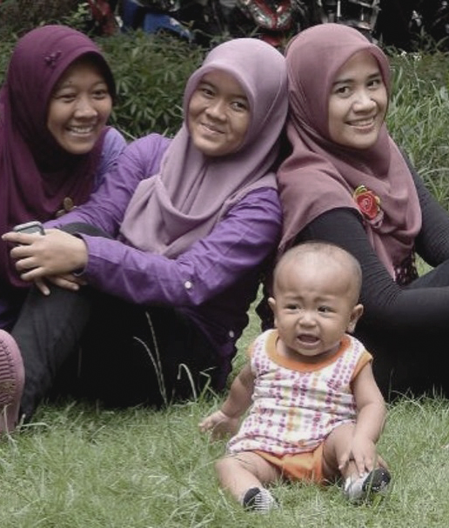
Engaging a Safety and Support Network
You cannot create safety solely with the people you are worried about.
What are the reasons families may not want to invite others to the table?
What is our responsibility as social workers in navigating these conversations?
Notes:
Purpose
To introduce the concept of building safety and support networks in our practice, and invite participants to discuss challenges and best practices related to network building.
Example
While we understand that we cannot build safety with a family in isolation (i.e., asking them to promise not to do the behaviors they have done before), there are many reasons why a parent might not want to invite others into the conversation.
In Chat (or Unmute)
Ask participants to share examples of the reasons families might not want to invite a network to the table. While all of this may be true, it is important that we do not shy away from these conversations with families.
The goal of building safety and support networks is that the family will:
Become less isolated;
Have people in their life by choice who can help them reduce risk and increase safety;
Reduce dependence on professional supports who will eventually go away; and
Reduce the likelihood of a new referral because the network stepped in.
Remember, professional involvement in the family’s life is temporary. The safety and support network can support the family over time, both now and in the future. Strengthening and involving families’ networks can help empower families to solve their own problems rather than depend on professionals.
Discussion
What are some of the ways you have found it to be successful in navigating these conversations?

Slide 33


What Is a Safety and Support Network?
They know and understand the worries about the child and the family.
They are willing
and able to support the child and family with specific and clear roles.
They include family, friends, and professionals who care about the child and the family.
Notes:
Purpose
To describe safety and support networks.
Example
A safety and support network is a group made up of family, friends, and professionals who work together to keep the child safe. They support the parents and the child, help the parents to act and remain accountable to the plan, keep eyes on the child, offer to care for the child during fragile or dangerous moments, and listen to the child and the child’s fears.
Ask the family who could help them develop a safety plan. This could be a friend, neighbor, relative, minister, therapist, etc. Keep in mind that the initial safety plan needs to be put in place immediately. There may not be time to gather a network of an ideal size. You may need to make a temporary plan to get to a family meeting and then make a more complete plan at a meeting.
The level of transparency and rigor involved in forming and maintaining the network is critical. Network members need to know the worry statements so that they can support the child’s safety and well-being. Cases involving more danger and risk can benefit from larger networks and greater network involvement. Even adding one person can make a huge difference.

Slide 34
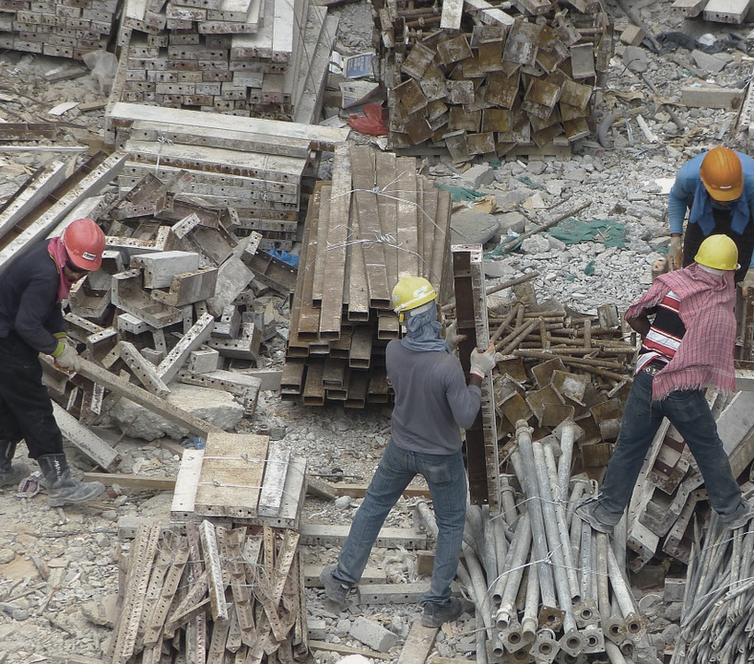
Building the Network: Tools and Strategies
Circles of Safety
and Support
Support Network Grid
Three Houses
Other?
Notes:
Purpose
To provide participants with resources that can support their practice.
Trainer Note
Ask participants to review Circles of Safety and Support, Support Network Grid, and The Three Houses in the participant guide.
Example
You can also use tools and strategies such as genograms, family trees, Support Network Grid, and Circles of Safety and Support as methods to help the family identify members of their safety and support network and consider involving these people in the safety plan.
Activity
Engage participants in sharing their favorite “go-to” questions or tools they use with families (who say they have no one) to come up with network members. Participants can share through a mentimeter so that responses create an ongoing visual/map, or in chat/un-mute and share. This is also a good spot for a breakout room for participants to practice the conversations they hold with caregivers to encourage identifying and engaging the network.
Trainer Note
To prompt discussion, you can ask the following.
What strategies do you use to support building a network? What do those conversations look like?
For groups feeling ambitious, try on a role play!
Resources
Circles of Safety and Support
Support Network Grid
www.menti.com (code: 1323 5540)

Slide 35
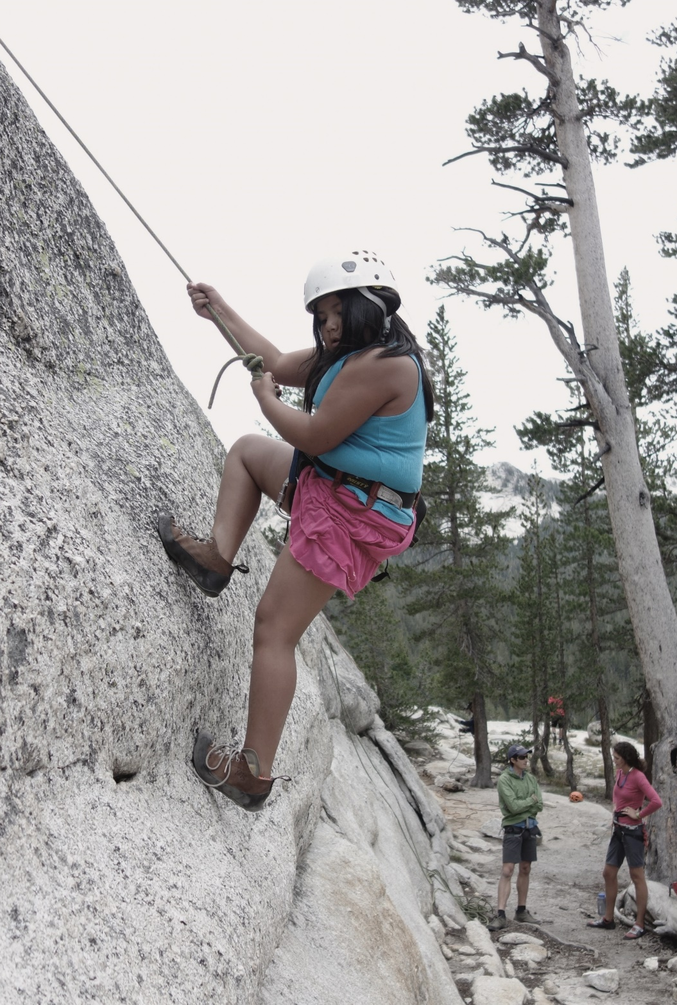
Building rigorous action steps
Notes:
Purpose
To have participants begin to think about what type of interventions go into a safety plan.
Example
When beginning to work with a family to identify interventions or action steps for a safety plan, it is important to note that a safety plan is not a case plan. The key distinction is that a safety plan starts immediately. It is addressing imminent danger of serious harm. It cannot rely on objectives or actions that won’t begin for days or weeks. It cannot rely on waiting to understand the underlying dynamics, let alone waiting for fundamental life changes to take hold.
To develop rigorous action steps that will work for each specific family, it is critical to pay attention to how you engage the family. The way you approach the family and ask questions during the process of assessing safety communicates to the family whether you are interested in them as a family and whether they will be given a voice.
Engagement does not mean ignoring danger. Safety planning requires communication that is straightforward and blunt - not subtle or sugarcoated. Even in circumstances with several hot safety threat items, you can be respectful, empathetic, objective, and culturally aware. We want to join with families and their safety and support networks in collaboration to develop rigorous action steps that will work for their family.
Think about a time where you were trying to create a plan for change around a personal pattern or habit. It might be something “small,” like eating healthier or quitting smoking, or something bigger that you have been trying to change for a while. Imagine a counselor, therapist, or friend is developing that plan for you. What might be missed? What difference might it make for a family if we could create space for true engagement and family voice in developing the action steps?

Slide 36

Establishing a Shared Definition of Safety
Actions of protection taken
by the parent/caregiver that mitigate the danger of immediate harm and are demonstrated over time.
Adapted from Boffa and Podesta (2004) and
Turnell and Essex (2006).
Notes:
Purpose
To clarify that safety does not mean the absence of new harm.
Example
Safety does not simply mean the absence of harm. It is important to establish a shared definition of safety that helps parents to think about safety as specific actions that can be taken and demonstrated over time.
Trainer Note
If participants are interested, you can provide the full citation below.
Boffa, J., & Podesta, H. (2004). Partnership and risk assessment in CYP protection practice, Protecting Children, 19(2), 36–48; Turnell, A., & Essex, S. (2006). Working with ‘denied’ CYP abuse. Berkshire, UK: Open University Press.

Slide 37

Safety and services are not the same thing
Safety
Services can be a bridge to new safe behaviors over time. They go on a case plan, not a safety plan.
From ACL 17-107: “In the case of a newborn affected by substance abuse, these action steps must address both the health and safety needs of the newborn and the substance abuse treatment needs of the affected family or caregiver to ensure the safety and well-being of the newborn. Thus, action steps shall include referrals to and delivery of services, as appropriate.”
Services
Notes:
Purpose
To remind participants that service completion does not equal safety of the child, showing differences between safety and strengths.
Example
Safety and services are not the same thing. Services are a means to an end, but that end is safety. While it is hard to determine if safety is occurring—certainly harder than continuing services—it also is the more meaningful question and more important to determine.
Trainer Note
ACL 17-107 “In the case of a newborn affected by substance abuse, these action steps must address both the health and safety needs of the newborn and the substance abuse treatment needs of the affected family or caregiver to ensure the safety and well-being of the newborn. Thus, action steps shall include referrals to and delivery of services, as appropriate.”

Slide 38


Eliciting Family Knowledge and Know-How
Ask good questions
Collaborate with the family
Consider cultural context
Involve
the child
Create monitoring and feedback loops
Notes:
Trainer Note
This slide is optional additional support, to be referenced as needed based on participant skill around engaging families in planning through solution-focused inquiry.
Example
Building strong plans for child safety is a collaborative process. Safety plans should always be developed with consideration given to the prevailing social and cultural conditions and way of life of the child’s family or tribe. Without exploring cultural context, you may omit or skip over ways that culturally relevant resources, network members, or action steps can help the family address the identified safety threats. The strongest safety plans require us to step into a space of true partnership with family members and their safety and support network, acknowledging that they hold the knowledge and know-how to help create the strongest plan that will work for them.
This is where your use of solution-focused questions and strong facilitation skills can help you. As you begin this conversation, it can be helpful to start by getting a lot of ideas on the table. Once clear about worry, invite the family and the network to think about all the possible things the caregiver, child, or network could do to protect child from the worry. The worker may have some non-negotiable elements, but if you immediately criticize an idea from the family, they will be less likely to offer more ideas.
If a family is stuck, you can offer ideas. If caregiver already took protective action, can they do more of that? You can offer, “I have worked with other families in similar situations, and they did X. How would that work for you?” When developmentally appropriate, children can and should be invited to offer ideas and suggestions for how to create safety in their homes.
After a range of ideas have been presented, start going through the ideas and ask key questions.
If that happened, would child be safe?
How likely is it that the person responsible for that action will follow through?
What if something happens, and the action does not happen?
This can help identify a variety of actions that directly protect child from the worry and backup plans to be sure the actions are happening and child is safe.

Slide 39
ELICITING FAMILY Knowledge AND
KNOW-HOW: SOLUTION-FOCUSED QUESTIONS
Exception
  Has there ever been a time when the problem could have occurred but did not?
Scaling
  On a scale from 0–10, where 10 is your child was totally safe and 0 is real danger, where were things when . . .
Relationship
  If your child were here right now, what do you think they would say they are worried about?
Coping
  What you are going through is not easy. How have you survived?
Preferred Future
  In six months, if everything we are working on has been resolved, what will be different in your family?
Notes:
Purpose​
To remind participants about solution-focused questions as a way to move into a more detailed discussion about how to elicit safety plans from families themselves.
Example
You can use solution focused questions to help generate and test ideas for safety plans. Here are some examples.
Exception questions. These are the cornerstone of solution-focused questions. They uncover instances where the problem could have occurred but did not. They help us get a balanced picture of the family and help everyone—including the family—see that change is possible.
Scaling questions. Yes-or-no questions can pigeonhole someone. For example: “When you were high last night, do you think your child was safe?” By asking a scaling question, you are more likely to engage the person in a discussion. For example, you might ask, “On a scale from 1 to 10, 1 being ‘not safe at all’ and 10 being ‘totally and completely safe,’ when you were high last night, how safe was your child?” Also, don’t make a plan without scaling family members’ willingness, confidence, and capacity. A person can be willing and confident but have no capacity.
Relationship questions. Who do you think would want to know? What do you think they would do with that knowledge? If your 2-year-old were here, what would he be saying he was worried about if he could talk with you?
Coping questions: Even though you have struggled with homelessness for the past nine months, you have still made sure your children attend school regularly and have a place to sleep each night. What strategies have you used to make sure your children’s daily needs are met?
Preferred future questions: When you think about a time when all of the worries you have been facing are solved, what will you notice about your family? What will your children notice?
Trainer Note
Review Solution-Focused Questions handout with the large group.​ Have them put a “*” by any questions that resonate with them and “?” by any they have questions on.
Optional: Ask participants for examples of questions that resonate and questions that raise questions.

Slide 40

Eliciting youth voice
Simple language
Developmentally appropriate strategies
Youth-guided support network
Sharing power
Notes:
Purpose
To give guidelines on including the voice of the child when creating safety plans.
Example
A key strategy for building rigorous and family-centered safety plans is eliciting the child’s voice. Often, the child understands best what options will help them feel safe. Also, youth can offer their own ideas and suggestions (when developmentally appropriate) for how to create safety in their homes.
Sharing power with youth is critical to building rigorous safety plans that will truly work. It is important to acknowledge the ways young people are often considered to be less important and in a sense inferior to adults. This is especially harmful within the child welfare system, as young people’s agency and decisions are often ripped away as professionals decide how important a youth’s voice is within their case.
Trainer Note
Open up discussion on ways to authentically involve the child in the safety plan. What is the difference between creating a safety net for the child versus setting the expectation in an ongoing way that the child is responsible for their own safety?
Reference participant guide handout: Moving From a Power-Over to a Powershare

Slide 41
Skills lab 2
Developing Rigorous Action Steps
As a Large Group
Review the Safety Intervention Ideas handout in the participant guide. Individually, take five minutes to highlight the interventions that you most often use and put a star next to any that are new ideas or that you have questions about.
In Small Groups
  Select one type of concern that you would like to explore further as a group.
  In what ways might you change or strengthen the listed intervention examples?
  What strategies do you use to ensure that a family has the chance to propose their own action steps before suggesting our ideas?
Notes:
Purpose
To introduce Skills Lab 2.
Trainer Note
Depending on time remaining, trainers may need to introduce this as an activity that may be beneficial to bring back to participants’ local teams as a follow-up prompt for coaching or team discussion.
Example
As a large group, review the Safety Intervention Ideas handout in the participant guide. Individually, highlight the interventions that you most often include, and note any that are new ideas and that you have questions about.
In Small Groups
Select one type of concern that you would like to explore further as a group.
In what ways might you change or strengthen the listed intervention examples?
What strategies do you use to ensure that a family has the chance to propose their own action steps before suggesting our ideas?

Slide 42
Skills lab 2
Safety plan versus Case Plan
In Small Groups
  Complete the Safety Planning Versus Case Planning activity in your participant guide.
  Discuss your answers. Were there aspects of the action steps that made this seem like a safety intervention even if it was not one?
  Assign a group member to report out to the large group.
Notes:
Purpose
Provide an alternative to Skills Lab 2, depending on participants’ desired areas of focus and trainer’s choice. Trainer should select only one of the “skills lab 2” activities provided.
Trainer Note
Have participants read the slide and get into small groups to complete the exercise.

Slide 43

Reaching agreement
Pause to consider power
and privilege once more.
What might it mean if you notice that you have proposed all the actions, or a family readily agrees to everything?
Notes:
Purpose
To have participants consider how not attending to power and privilege can impact the rigor of a safety plan.
Example
There are a couple of situations that might be a sign to pause to consider the rigor of the plan.
Situation 1: The family readily agrees to everything, but you aren’t sure they are really committed to the safety actions.
You’ve probably been in situations where the family says yes to everything. They are the most agreeable family ever. You are ultimately responsible for noticing when this is happening, and what it might mean if a family readily agrees to everything you propose. It’s not enough just to walk away and accept their statements at face value when your professional judgment is sound and telling you the child will not be safe.
Consider ways to address this directly and invite them into a conversation reconsidering the action steps. You may also consider whether increasing the monitoring would provide the assurance that the family really is doing what they say they will. Are they agreeable to unannounced visits? Can the child call in every daytime hour for the first 48 hours? Can grandma move in for the weekend?
Situation 2: The worker and family do not agree on the safety interventions.
We’ve already said that if the worker and the family disagree on whether the threat is present, the worker should mark the threat as present AND give voice to the family’s perspective by noting their point of view. What if they disagree with the only plan the worker thinks is viable?
The fundamental principle is that at this point, the worker is ultimately responsible for child safety. We cannot neglect our professional responsibility by either accepting a plan we doubt will work, or simply saying that the family was unwilling, so we will close the case.
But we don’t have to be rigid, either. Ask the family what they would be willing to do — how could this plan be made acceptable to them? Ask yourself if their amendment would really compromise child safety. Sometimes it won’t. For example, they prefer dad’s brother to be the child’s safe place, rather than mom’s sister. Unless you have reason to think the paternal uncle would not be safe, there’s no reason to object.
Conversely, knowing that if the family won’t agree to a plan, the child will go into foster care—and the plan could be so simple that you can’t understand why the parents won’t just say yes—how hard should you try to persuade them?
It is necessary to ensure that you aren’t being coercive when developing the safety plan. Parents have to see and understand safety plans as a voluntary agreement that they are entering into, and they have to know that the interventions are time-limited. There was a related case in the Illinois State Supreme Court (Dupuy v. Samuels) that challenged the constitutionality of safety plans. While the court ultimately supported the practice of safety plans in CPS, it did prompt several clarifications about practice expectations by the agency.
There is no substitute for good clinical judgment here. You want to be sure they understand how easy the plan would be, and how much even one night in foster care would affect their child. See if you can figure out what hook will work best, and use it. But if you feel you are pushing them to just say yes when they mean no, and they aren’t really buying into the plan, then it’s best to not push too hard, or you may just be setting up a safety plan for failure.
Safety plans must be clear, voluntary, time-limited, and not coercive. Removal is a potential consequence of failure to comply with safety planning, but it should not be presented as a threat.
Trainer Note
Dupuy v. Samuels is a case brought in 1997 in Illinois by 150,000 residents of that state. The crucial portion of the case (for purposes of safety planning) concerned parents’ allegations that they were illegally and unconstitutionally forced to comply with safety plans under threat of child removal. This issue was considered in the “Dupuy II” claim brought in 2002, in which the court found that safety plans that last more than “a few days” violate families’ rights to due process. The court elaborated that “more than a few days” means a review of any safety plan is required after 14 days. In a 2006 appeal of the decision, the court found that safety plans must be uniformly voluntary; it also criticized certain coercive practices (e.g., threatening families with foster care placement) that the court found to be common in safety planning. The issue remains subject to appeal, but clear, voluntary, time-limited, non-coercive safety plans remain good practice.

Slide 44

Clear timelines and plans for monitoring
Clear timelines: All safety plans should have a clear date for revisiting the plan for revision or resolution.
Plan for monitoring: Describe and review what next steps should be taken if the plan, as written, isn’t working.
Signatures: Get them from at least one caregiver and one protective adult.
Notes:
Purpose
To highlight the importance of developing a clear and time-limited plan for monitoring.
Example
Plans should:
Have clear timelines for how long they will be in place, no longer than 30 days. Clarify that at this point, the plan will be reviewed and either renewed, adjusted, or allowed to expire (resolved).
Describe a plan for monitoring, including how you will know if each part of the plan is working. Will the family report to you? Will you call the agency to be sure they can help? Will you make unannounced visits? Will grandmother stop at the house every day and call the worker if there is a problem?
The safety plan should be signed by the worker, at least one caregiver, and at least one protective adult responsible for supporting the plan. The worker can use clinical judgment as to whether both should sign and whether to accept a plan the caregiver refuses to sign. The worker should sign. Additionally, have children old enough to do so sign the plan. If there are any other individuals you are relying on to participate in the plan, they must sign. For example, if part of the plan is for a neighbor to help with afterschool childcare, the neighbor must sign to verify willingness.
Be approved by a supervisor

Slide 45

Documentation and Warm Handoffs
Make sure the family
has a copy of the plan.
Enter it into CWS/CMS.
Documentation and warm
handoffs supporting transfers.
Review and update the
safety assessment.
Notes:
Purpose
To explain documentation of the safety plan and the need for a new safety assessment.
Example
Ideally, a safety plan document should be available in triplicate, so you can leave one copy with the family and place one copy in the file, or use your camera to take a picture of the plan that you leave with the family.
Because it is hard copy, each county may have a policy regarding how the safety plan should be reflected in CWS/CMS. ACL 22-02 provides additional guidance for documenting safety plans in CWS/CMS, including use of a Special Project Code (SPC), Safety Plan Completed.
Warm Handoffs
Since change takes time, you may need to transfer a family with an active safety plan to a new social worker. This is where the importance of clear documentation of the plan put in place, as well as conversations to support warm a hand-off of the plan, can be critical.
If a family has resolved the safety threat, a new safety assessment should be completed to document the household as safe prior to referral or the case being closed. Referrals and cases should not be closed out with an active safety plan.

Slide 46
Closing and next steps

Slide 47

Reflection:
Your next steps
What is one thing that stuck with you that you are going to build into your practice going forward?
What do you want to bring back to your team to encourage system infrastructure that supports strong safety planning practice?
Notes:
Purpose
To allow participants to engage in planning for putting skills into practice.
Trainer Note
Depending on amount of time, this activity can be done in small breakout groups, or in chat.
Example
Have participants consider the questions on the slide, elicit responses, and engage participants in discussion about the day. Conclude by going around and asking each person add their thoughts to the chat.

Slide 48
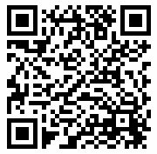
Training Evaluation
Please help us improve the delivery of this training for your peers
across California
by submitting
your feedback.
Notes:
Trainer Note
Link to be shared in chat: https://surveys.evidentchange.org/s3/CDSS-Safety-Planning-Training-Evaluation
If local county or organization has a specific training evaluation, that evaluation should replace this slide.

Slide 49
THANK YOU & QUESTIONS
EvidentChange.org
(800) 306-6223 Info@EvidentChange.org

Slide 50
Supplemental materials
Notes:
The additional materials are available for trainers to reference to supplement training discussion as needed.

Slide 51
Three-Column map
What Are We Worried About? | What Is Working Well? | What Needs to Happen Next?
Harm, danger, risk, and complicating factors | Safety, protective capacities, and strengths | Safety planning, creating and sharing a worry statement, enhancing a safety and support network
0
10
Notes:
Purpose
To engage participants in a conversation about three-column mapping and engaging families.
Trainer’s Note
Review the three-column map.
Let’s assume you have a reasonably cooperative family, and that the danger is not so immediate that it precludes working your way through this process.
The first step is to identify what the family has to build on. We are looking for actions of protection and household strengths. Strengths and actions of protection are not the same thing. Actions of protection are specific, immediately available skills or characteristics that can directly mitigate the existing safety threat. Take a look at the definitions of both actions of protection and household strengths in your SDM policy and procedures manual.
We are still on the question of safety, so we are not talking about having a psychological assessment scheduled in four weeks to find out whether these capacities are present. If you have evidence of its presence, mark it. If not, leave it blank. There is not a NO option here because not marking it doesn’t necessarily mean that the family doesn’t have that capacity, only that you don’t have information about that yet and therefore won’t be able to rely on it as you think about safety planning. So, how can you quickly review household strengths and actions of protection with the family?
Remember that you’ve already done some interviewing and observing to determine whether safety threats were present. Along the way, you may have already discovered some of the family’s protective capacities. Go ahead and mark (or if you don’t have the form, mentally mark) any that you already know. Tell the family about any that you’ve already observed. By starting with a statement to the family that you notice something positive about them, you can help them realize you aren’t just “out to get them.”
Use the definitions to ask additional questions. In the participant guide, you’ll find some examples of ways you can ask a few simple questions to uncover potential actions of protection in the household.
If you cannot identify actions of protection in the caregiver, the child, or the safety and support network — either because the caregivers can’t be located or won’t cooperate at all — you can’t build an in-home safety plan. If you don’t have a parent who is engaged and able to understand the danger, it’s pretty hard to imagine how you could build a plan without bringing in outside individuals to completely protect the child. An example might be a caregiver who is temporarily incapacitated—in a coma in the hospital, but likely to recover.
(Trainer Note: The pressure at the other end of the continuum—to get the safety plan done quickly—is worker convenience/workload. That is not a good reason to rush. You might get a safety plan done quickly, but if the plan does not have buy-in, it is more likely to fail and result in the need for placement. That is time-consuming and costly. Rushing through safety planning is a false economy that costs more in the long run. Engaging the family in safety planning also sets the stage for longer‑term planning.)
Next, remind the family of the specific threat or threats that must be addressed and what they have to work with, and ask them what they think they could do or arrange to ensure that the child is protected from danger. Asking the family first doesn’t mean you’ll accept their suggestion—you’ll see that in the next step. But asking them first implies that you are willing to listen, that you are willing to see their capability, and that they may have a great idea. If they have no ideas or limited, unlikely ideas, you can offer suggestions. But make them suggestions at this point.
The medical field is learning that if you really want patients to follow medical plans, you can’t just say, “Here’s your prescription.” Instead, better results are seen from patients of doctors who explain the available options, who discuss the pros and cons, and who ask patients how likely they will be to follow a plan—and who help resolve barriers to following a plan.
One starter phrase is, “Some families have tried this … .” What are some other options? (“I heard about … ” “What would you think of … ?”)
The participant guide has some ideas for safety plan interventions. For each safety threat, there are several suggestions.
(Trainer Note: Review a few of the interventions. Note the mix of formal and informal activities.)
Ideally, get all the ideas on the table first. This is just basic brainstorming technique. If we start to critique ideas as they are presented, it tends to stifle ideas. But again, remember that in some situations, you have to press forward faster because of the immediacy of the danger. When you can, wait until a number of ideas are on the table before proceeding to testing the ideas. Don’t skip this step! Not all good ideas will work. Ask how each proposed idea will directly protect the child from the specific threat. Ask what could go wrong. Use this information to develop contingencies so that the plan is detailed and complete. Some ideas will be rejected because during this step you’ll realize they’re not feasible, won’t be robust enough protection, or have some other limitation.
Now, you can assemble your final plan. Write it on the safety plan document. Be specific about who will do what, and when.
A vital component of the plan is monitoring. How will you know the plan is being carried out and is protecting the child? For each plan element, ask, “How will the worker know this is being done?” For the overall plan, ask, “How will the worker know the child is safe?”
Trainer Note
Here are some possible prompts for discussion:
What are ways that this would change the questions you are asking?
How might this change the outcome of efforts of engaging with a family?
How does this change the perspective?
Does anything stand out for you regarding how the columns are broken up?

Slide 52



Caregiver + behavior + impact
Caregiver
Behavior
Impact on the Child
Notes:
Purpose
To highlight Caregiver + Behavior + Impact (C + B + I).
Example
When gathering information from the caller, it is important to stay focused on the link between a caregiver’s actions or behaviors and their impact (or potential impact) on the child. We’ll take a look at some strategies for digging for these behavioral details.

Slide 53
Another Format for harm and worry statements
Add the Context of Danger
Adam may be bruised and even more seriously injured if his father, Matt, hits him when he is drunk.
may be
if/when
Child
Impacted how?
Context
Notes:
Purpose
To offer another way to frame harm and worry statements.
Example
You can also bring into the worry statement the specific context in which the danger and caregiver action/inaction occurs. For example, describing the caregiver action in the context of a potential complicating behavior or conditions (e.g., the child may be impacted if/when the father uses physical discipline with his children when he loses his temper when he is drinking).
This can support the caregiver by acknowledging that concerning behaviors often occur in specific contexts, which can help reduce feelings of blame or shame around by highlighting the concern as a specific behavior vs. the caregiver essence.
Trainer Note
This slide is optional additional support, to be referenced as needed based on participant skill around harm/danger statements.

Slide 54
Example: Honoring Good Intentions
Because Elena cares deeply about family and because it is important to her that her son has a good relationship with his father, CPS is worried that Elena may continue to bring Tomas Jr. to meet his dad alone (without a support person) and that Tomas Sr. may get angry, hit Elena or Tomas Jr., and Elena and Tomas Jr. could be seriously hurt.
Notes:
Purpose
To provide an example of a worry statement that opens with a positive statement about a caregiver.
Example
Here is an example of a worry statement that honors good intentions of a parent. What difference might it make to the parent in phrasing your danger statement in this fashion?
Trainer Note
This slide is optional additional support, to be referenced as needed based on participant skill around harm/danger statements.

Slide 55
“Denial” Example
Because baby Anna suffered bleeding in the brain while in mom and dad’s care in October and because no one knows how the injuries happened, CPS and hospital doctors are worried that if nothing changes, Anna could be seriously injured again, suffer permanent brain damage, or even die.
Notes:
Purpose
To provide an example of a worry statement that concerns denial of the caregivers.
Example
Here is an example of a worry statement in a situation where the caregivers are not admitting to causing harm; it allows everyone to reach agreement on what the danger to the child is, based upon what has already happened to the child.
Trainer Note
This slide is optional additional support, to be referenced as needed based on participant skill around harm and worry statements.

Slide 56
Domestic Violence
Notes:
Purpose
To describe considerations of the safety plan when domestic violence is present in the household.
Example
Some families have domestic violence concerns that co‑occur with child maltreatment. Regardless of whether or not the violence is at the level of a safety threat, whenever domestic violence dynamics are present, the worker needs to be aware of family safety even while focusing on child safety.
There are a few special considerations. While it isn’t always the case, there is usually one caregiver who is in a victim role and one who is in an aggressor role. The intervention of CPS, no matter how necessary, can increase the danger to the victim.
Of course, you should have already conducted a private interview with the apparent adult victim. Likewise, you should discuss safety planning with the adult victim (with or without support people of his/her choosing). Do not include the aggressor in these first discussions. Why? (Answer: If done jointly, aggressor will influence the plan to his/her advantage and/or you will not be able to include elements to keep the victim safe.)
In some instances, where the violence/power imbalance has been minor and brief, the victim may be willing to develop a joint safety plan. Use your professional judgment. Is the victim in denial about the danger? Is the victim feeling coerced into sharing the plan? If so, don’t do it.
If you do create a shared plan, work separately with the victim for a personal safety plan, just in case. In other instances, you may need to have a safety plan with the aggressor AND a safety plan with the victim.
Be careful about copies of written safety plans that contain information the aggressor should not see, such as escape plans.
Always discuss any safety plan with the victim first. Discuss the safety plan with the perpetrator only if the victim agrees and your professional judgment is that it would be safe to do so.

Slide 57

Strengths-Based Communication Techniques
Stance of “not knowing”
Respect
Experts in their own lives
Capitalize on past successes
Elicit and identify strengths related to protective factors
Notes:
Purpose
To review strengths-based communication techniques.
Example
Maintain a stance of ”not knowing” with families.
It is important to keep in mind that each family is different.
Set aside your own preconceptions, and postpone your judgment. This means not making assumptions about what families can or cannot do; what they will or will not comply with; or what they do or do not want.
Show respect. Listening is the key. Never assume you know what the family means.
Families are the experts in their own lives. Approach families with “great curiosity” and ask thoughtful questions.
Capitalize on past successes. Ask families about a time when they were successful (or competent) in resolving a similar situation. How could those successes be applied to the current situation? Focus on what is already there, rather than what is not there.
Elicit and identify strengths related to protective factors. During a Team Decision Making™ (TDM) meeting, there are many opportunities for a family to show their strengths when the child welfare professional uses strengths-based communication.

Slide 58

Key Benefits of a Strengths-Based Perspective
Improves chances for best possible solution
Empowers families to offer their best thinking
Generates cooperation, positive energy, creativity
Increases family’s buy-in
Notes:
Purpose
To review key benefits of practicing with a strengths-based perspective.
Example
Having more options for resolution improves the chances for finding the best possible solution.
The family has a specific, dedicated opportunity to share their best thinking about working out solutions.
The family’s role and experience in finding solutions is respected.
Family must be encouraged to bring in people who represent their support systems to help with solutions. The presence of support systems helps to ensure safety by encouraging the use of resources and strengths of families, as well as friends, relatives, and the community. It extends the circle of people who care; it creates partnerships of people who agree to help in specific ways; and it ensures that the family is not being overloaded with services or obligations.
A strengths-based approach empowers and supports family and children. It empowers families to offer their best thinking. Families appreciate having their strengths and competencies acknowledged and their positive efforts credited.
Looking for strengths generates cooperation, positive energy and creativity. People respond well to a strengths-based approach; they generally get defensive when the focus is on their deficits. Unfortunately, that is the typical experience for families interacting with the child welfare system.
A strengths-based perspective increases family’s “buy-in” for implementation, as the family’s participation in the planning process creates a sense of ownership. “Those who plan the battle do not battle the plan.”
Trainer Note
Ask participants about ways to set up opportunities for families to show their strengths and solicit responses. Be sure the following points are mentioned.
Ask the family to elicit strengths about themselves and other family members.
Keep ears open for family’s protective capacity/factors such as ways that a parent has shown resilience, people who they have in their life who can be part of a safety and support network, parenting and communication, etc.
Label strengths that family members may not see as strengths.
Elicit strengths related to current situation that will help address situation.
Make statements of belief in family strengths.
Identify strengths that we see during the meeting: “You’ve come to the meeting — you love/care about your child.”
Use WE — establish who “we” are
Remind participants that:
No problem happens all of the time.
Ask about present strengths and past successes; both types of strengths could contain the keys to solve current situations.
Stay close to the issues surfaced by the current situation (do not stray to past successes that are not relevant to the current situation).
Have community partners come prepared to speak to family strengths.
Explore the reservoir of strengths in extended family and community to resolve issues of concern.

Slide 59
There are concerns around mom’s ability to provide basic food and clothing needs for her children (ages 3, 5, and 9), and a COVID-related job loss prompts an investigation where you find little to no food in the home. The children’s clothes are soiled.
What would be the first intervention you would choose from the list below to address the safety threat?
Relative drops food at the door.
Mom promises that she will have food by the next visit.
Friend who is regularly coming to the home anyway agrees to pick up and drop off laundry for the children.
Teacher agrees to check in with children during Zoom virtual meeting.
Worker provides groceries or immediate resources to obtain food.
Mom agrees to take a health and nutrition class.
Mom agrees to FaceTime worker to show her available food.
Children using safety object to indicate need to neighbor.
Notes:
Purpose
To practice with safety interventions.
Trainer Note
Have participants complete the activity on the slide.

Slide 60
Concerns around mom's inability to provide for the basic food and clothing needs for her children (ages 3, 5, 9), a COVID-related job loss prompts an investigation where you find little to no food in the home. The children's clothes are soiled.
What would be the second intervention you would choose from the list below to address the safety threat?
Relative drops food at the door.
Mom promises that she will have food by the next visit.
Friend who is regularly coming to the home anyway agrees to pick up and drop off laundry for the children.
Teacher agrees to check in with children during Zoom virtual meeting.
Worker provides groceries or immediate resources to obtain food.
Mom agrees to take a health and nutrition class.
Mom agrees to facetime worker to show her available food.
Children using safety object to indicate need to neighbor.

Slide 61

Two Plans for Cheryl
Notes:
Trainer Note
Breakout Session
Have participants look at the two different plans for Cheryl in small groups for five to seven minutes. What do they notice? What do they like about each plan? What has them worried?
Write the following.
Pretend you supervise Cheryl’s worker. If that worker came to you with both Plan 1 and Plan 2, which would you choose? Why?
If the workers you supervise were here right now and we asked them about each of the two plans, what might they say they prefer? Why?
If Cheryl were here right now and we asked her what she thought about each of the plans, what might she say?

Slide 62
Collaborative safety planning
When there is reason to know that a child in the household is an Indian child, active efforts must be made prior to removal of the child.
Safety plans should always be developed in consultation with the tribe, with consideration given to the prevailing social and cultural conditions and way of life of the child’s tribe as described in
MPP 31-127-23.
Notes:
Purpose
To learn how collaborative safety planning with tribes is an essential part of making active efforts as set forth in the ICWA.
Example
When there is reason to know that a child in the household is an Indian child, active efforts must be made prior to removal of the child, except in the case of emergency removal of an Indian child when there is imminent physical harm or danger.
Active efforts are described in MPP 31-002(a)(1): Safety plans should always be developed in consultation with the tribe, with consideration given to the prevailing social and cultural conditions and way of life of the child’s tribe as described in MPP 31-127-23. Consider the use of tribal resources, tribal community service agencies, and/or ICWA program staff to help the family address the identified safety threats and participate in the safety plan.

